Slide 1
SECURE DATA HIDING IN IMAGES USING STEGANOGRAPHY
CAPSTONE PROJECT
Presented By: A.Amreen
Student Name : A.Amreen
College Name & Department :St. Johns College of Engineering and Technology and CSE-Data Science

Slide 2
OUTLINE
Problem Statement
Technology used
Wow factor
End users
Result
Conclusion
Git-hub Link
Future scope

Slide 3
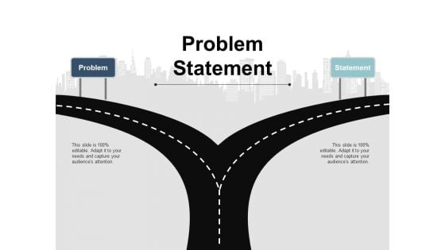
Problem Statement
With the rise of digital communication, securing sensitive information has become a major concern. Traditional encryption methods protect data but make it clear that hidden information exists. Steganography offers a way to hide data within images, making it nearly undetectable. This project focuses on developing a technique to embed secret messages in images without altering their appearance. The goal is to ensure data security while maintaining image quality. The challenge lies in balancing security, capacity, and imperceptibility. By implementing effective steganographic techniques, this approach can be useful in secure communication, watermarking, and protecting confidential data from unauthorized access.

Slide 4

Technology used
This project uses Python as the primary programming language due to its simplicity and powerful libraries.
The Pillow library is used for handling image processing, while OpenCV helps with advanced image manipulation.
NumPy is used for numerical operations, and Matplotlib is helpful for visualizing image changes.
LSB (Least Significant Bit) steganography is the main technique for hiding data in images.
The project runs on platforms like Windows, Linux, and macOS.
For a user-friendly interface, Tkinter or Flask can be used.
This combination ensures secure data hiding while maintaining image quality and usability in real-world applications.

Slide 5

Wow factors
Invisible Data Hiding: Uses Least Significant Bit (LSB) steganography,
ensuring secret data remains undetectable to the human eye.
High Security: Supports password-protected encryption, adding an extra layer
of security.
Cross-Platform Compatibility: Works on Windows, Linux, and macOS, making
it accessible to all users.
User-Friendly Interface: Provides a GUI with Tkinter or a web-based interface using Flask, making it easy to use.
Multiple File Format Support: Allows embedding data in PNG, JPEG, and BMP images.
Efficient & Fast Processing: Optimized using Python libraries like OpenCV, Pillow, and NumPy for quick execution.

Slide 6

End users
Government Agencies: Used for secure communication and confidential data transfer.
Journalists & Whistleblowers: Helps safely share sensitive information without detection.
Cybersecurity Experts: Used for testing and developing secure communication methods.
Military & Intelligence Services: Ensures covert messaging in critical operations.
Researchers & Academics: Useful for studying and improving data security techniques.
Businesses & Corporations: Protects trade secrets and confidential documents.
General Users: Individuals who want to keep personal data private and secure.
This project benefits anyone needing safe, hidden communication while maintaining image quality.

Slide 7

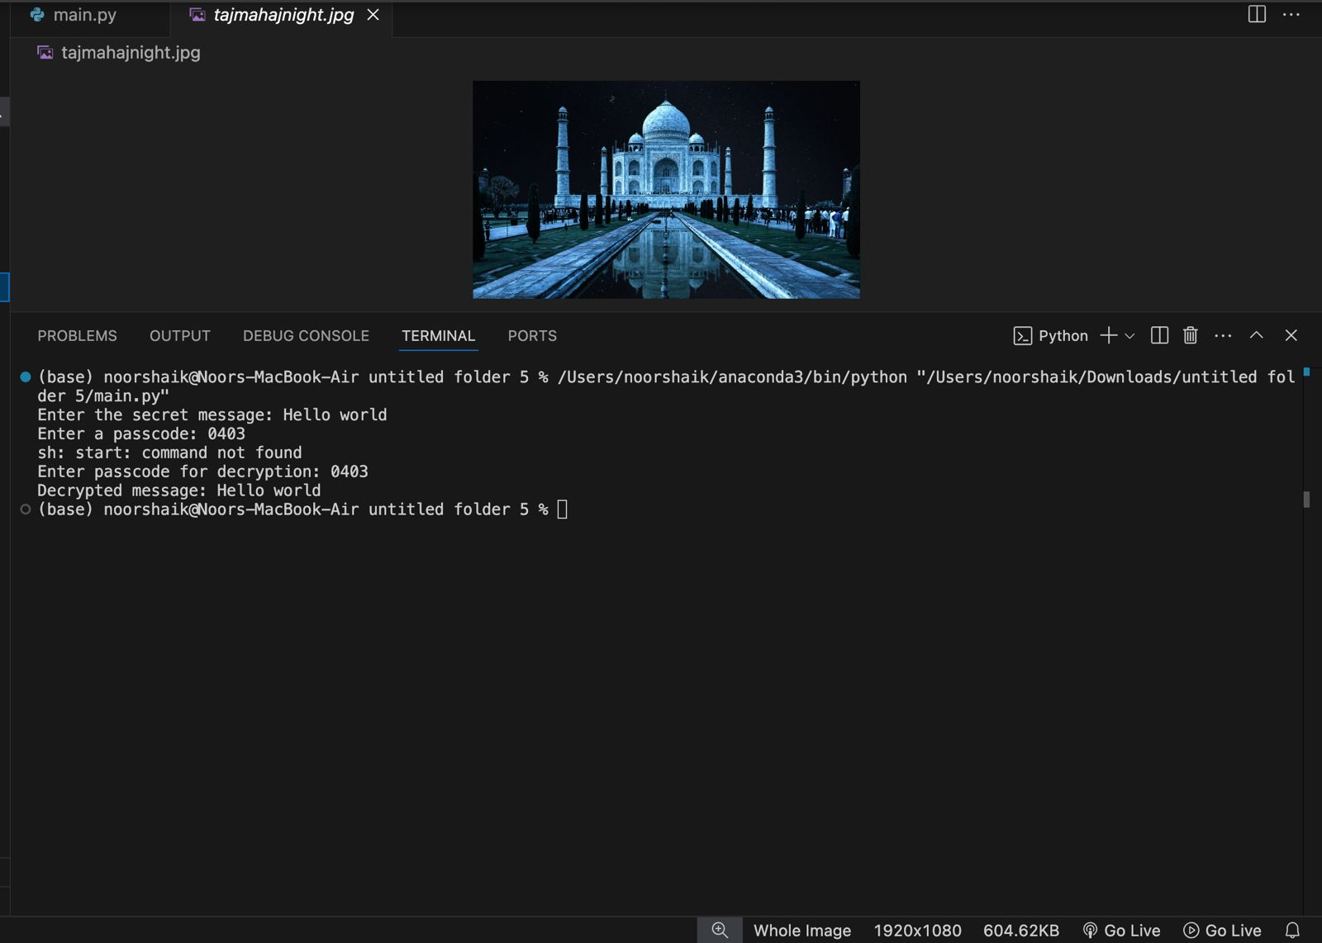
Results

Slide 8

Conclusion
Steganography is a powerful method for secure data hiding, ensuring privacy and confidentiality in digital communication. This project successfully embeds secret messages in images using Least Significant Bit (LSB) steganography, making the data invisible to the human eye. With Python libraries like OpenCV, Pillow, and NumPy, the system maintains high security while preserving image quality. The project can be useful for government agencies, businesses, journalists, and individuals who need safe communication. By combining encryption with steganography, this approach enhances data protection. In the future, advanced techniques like AI-based steganography can further improve security and efficiency in hidden data transfer.

Slide 9
GitHub Link
GitHub: https://github.com/Amreen-0786/Secure-Data-Hiding-in-Images-using-Stegnography

Slide 10

Future scope(optional)
The future of secure data hiding using steganography holds great potential. Advanced techniques like AI-based steganography can improve security by making hidden data even harder to detect. Adaptive steganography can adjust hiding methods based on image properties for better secrecy. Blockchain integration can ensure data authenticity and prevent tampering. Support for audio and video steganography can expand its applications. Enhancing encryption algorithms will add extra security layers. Real-time mobile applications can make secure communication more accessible. These improvements will help governments, businesses, and individuals protect confidential information more efficiently in the digital world.

Slide 11


